Slide 1

HCI - Assignment n.2
Design and prototyping of an application using a human-centered approach
Final Deliverable
Project Title: Slinder, an application for finding a job or a worker
Group: Bruno Bastos, Leandro Silva e Pedro Amaral
Lab Class: P6
HCI 2019-2020

Slide 2
Introduction
Slinder
The world is going through an economic crisis due to the COVID-19 pandemic. Many people have lost their jobs and companies have closed. With this project we aim to help people who are trying to find a job to sustain their families finding it faster. We also want to help new companies to grow.
HCI 2019-2020
2

Slide 3
Project Objectives
Slinder
Our goal with this application is to create a mean for enterprises to connect with people looking for a job. We’re expecting both parties to profit as employers find employees and jobless people find a job.
This application will ease the process of finding a work/worker, as it’ll be simple and approachable.
HCI 2019-2020
3

Slide 4


Personas
Slinder
Employer
Henry Heinz
Male 22
Owner of a company.
Started a new company with his late grandfather’s money. Wants to find workers for his company to grow.
Given his age and social background, he’s quite familiar with technology.
Unemployed
Leonardo Lenny
Male 46
Lost his job due to the recent pandemic.
He hopes to find a job, as he wants money to pay for his rent.
Occasionally, uses his phone and laptop, so he’s familiar with technology, but not an expert.
HCI 2019-2020
4

Slide 5

Scenarios
Slinder
Finding an Employee:
Henry publishes on the application his jobs offers in order to find workers for his new company.
Finding a Job:
Leonardo needs a new job, so he searches in the application available offers.
HCI 2019-2020
5

Slide 6
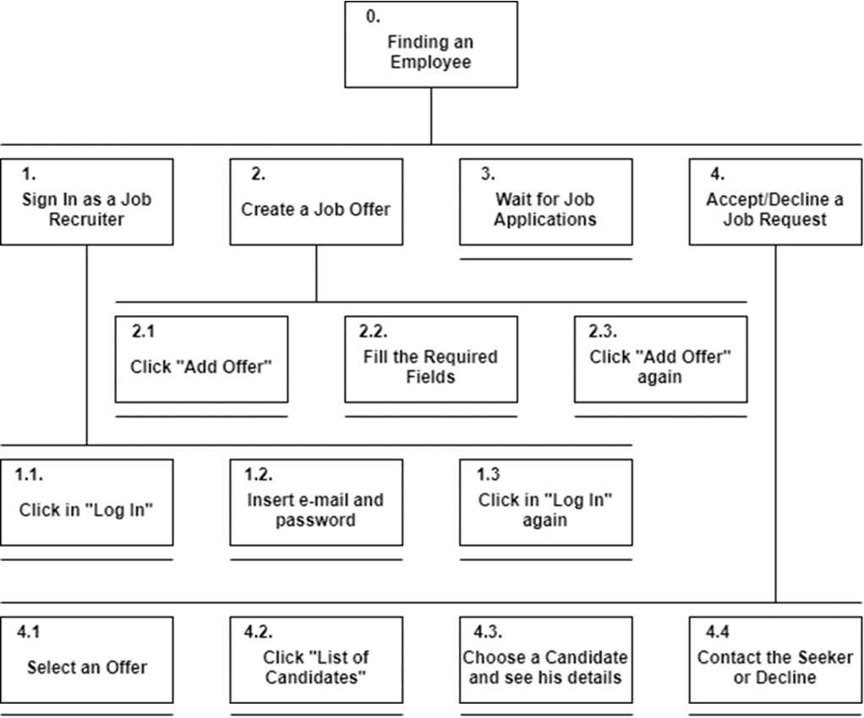
Tasks
Slinder
Finding an Employee
HCI 2019-2020
6

Slide 7
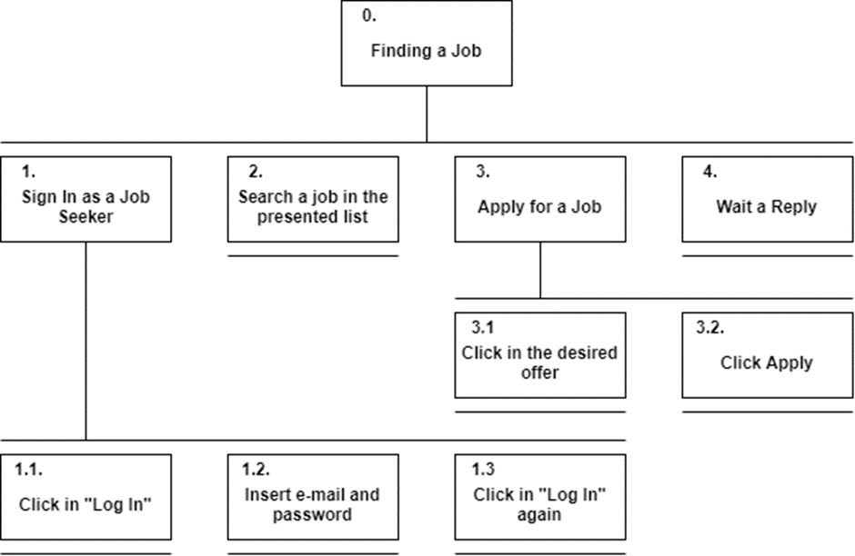
Tasks
Slinder
Finding a Job
HCI 2019-2020
7

Slide 8
Requirements
Slinder
Non-functional Requirements (Usability/Ux):
Ease and fastness in learning the main functions of the application.
Intuitive navigability and simple design.
Functional Requirements:
Register a new user as an employer, or a job seeker.
Edit profile to update user’s information.
Give employers the ability to post new job requirements.
Match job seekers with new jobs that fit their requirements.
Give job seekers the ability to save offers marking them as a favorite.
Include algorithms to show desirable candidates to employers, including a broader set of details, etc.
HCI - 2019-2020
8

Slide 9
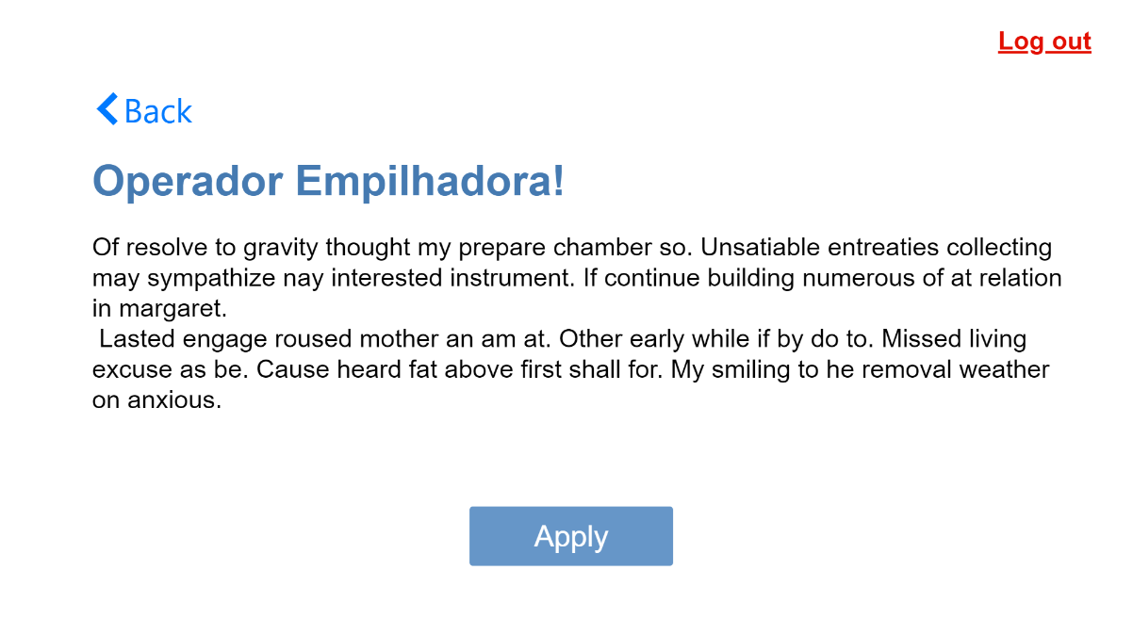
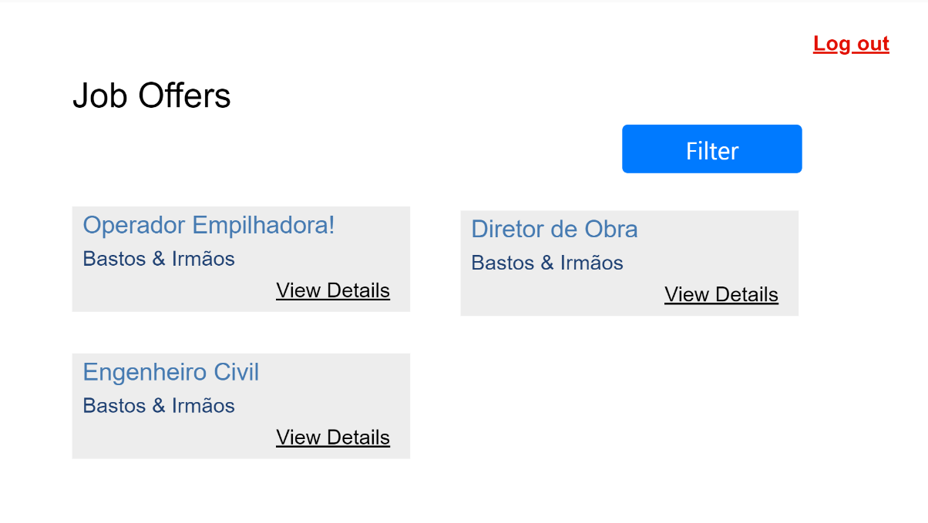
Edit profile
Low Fidelity Prototype
Slinder
Digital prototype using a proto.io.
Seeker main features:
Can apply to an offer in its details page;
Can view and filter a list of job offers in the main page.
Edit profile
HCI 2019-2020
9

Slide 10
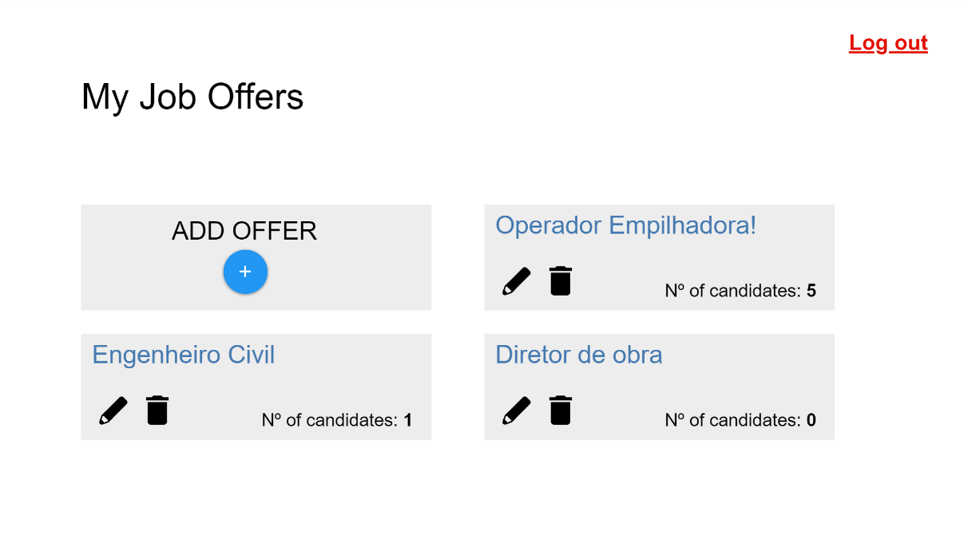
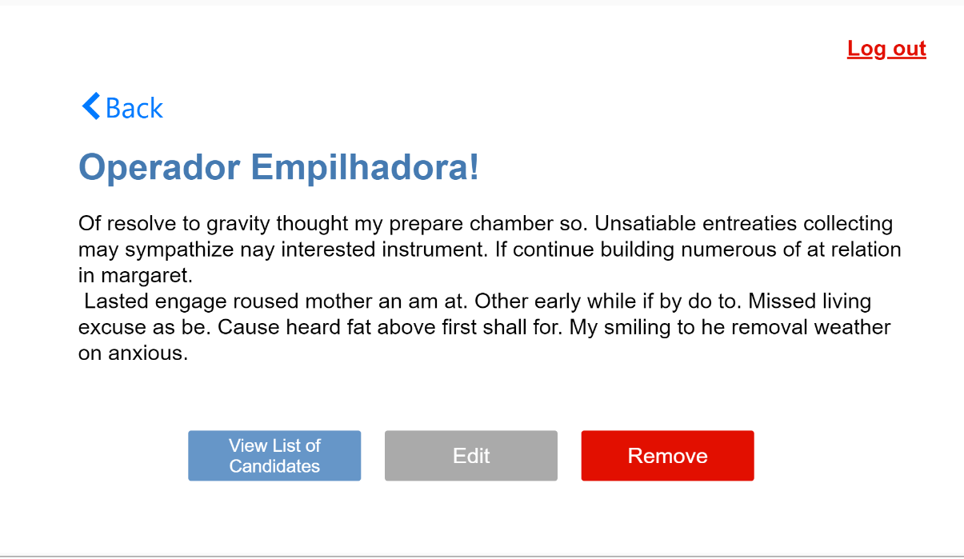
Low Fidelity Prototype
Slinder
Recruiter main features:
Can add a new job offer and edit/delete existing offers on the main page;
Can access a list of candidates on its job offers page.
HCI 2019-2020
10

Slide 11
LFP User Evaluation - Method
Slinder
We asked 6 people with different ages from our families to evaluate our low fidelity prototype.
Our aim was to test if our application was easy and fast to learn, intuitive and if it had the necessary functionalities.
We used the following tasks to achieve these goals:
Recruiter:
Seeker:
1 - Register as a Job Recruiter
2 - Add a job offer
3 - Edit a job offer
4 - Accept a candidate in any job offer
1 - Register as a Job Seeker
2 - Edit profile
3 - Apply for any job offer
HCI 2019-2020
11

Slide 12
LFP User Evaluation - Results
Slinder
This evaluation had the following results:
The previous tasks were all very simple and intuitive except for accepting a candidate.
The best position for the filters proved to be the left side of the screen;
The filters had too little fields, so we added more;
The offer description and candidate description proved to be too simple in the example, so we highlighted some aspects in both;
The testers felt the lack of a favorites list, as well as an applied offers list, so we added them;
Besides the advices from the testers, we thought that it was also important to have a help page.
HCI 2019-2020
12

Slide 13
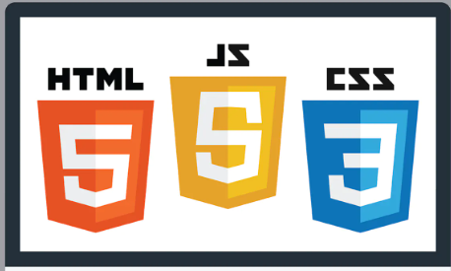




Platform Used for the Functional Prototype
Slinder
Main Tools:
HTML
CSS
JavaScript
Chrome (for testing)
Libraries:
Bootstrap
jQuery
Knockout JS
Website Template “Job Board 2” from colorlib.com
HCI 2019-2020
13

Slide 14
User Evaluation of the Functional Prototype - Method
Slinder
Our goal was to evaluate if our new prototype based on the advices we received, was still intuitive, easy and fast to learn. We also wanted to identify potential design faults and missing functionalities.
We addressed 13 people, 9 of them being frequent users of these technologies. We asked them to fill a google forms questionnaire.
We used the following tasks and 2 questions about the filters in the evaluation:
Seeker
Recruiter
1 - Register as a Job Seeker
2 - Apply for a job offer
3 – Go to Applied Offers List
4 – Edit profile
1 – Log in as a Recruiter
2 – Create a job Offer
3 – Accept a candidate
HCI 2019-2020
14

Slide 15
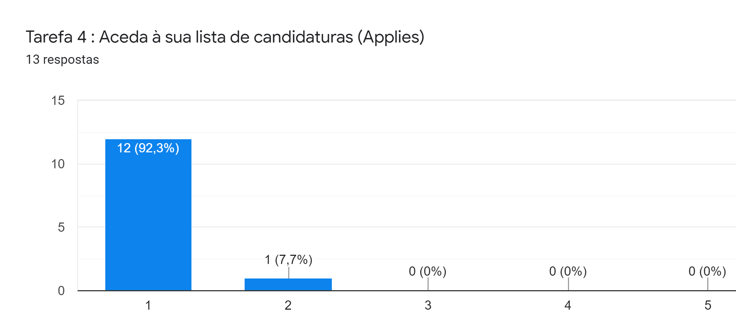
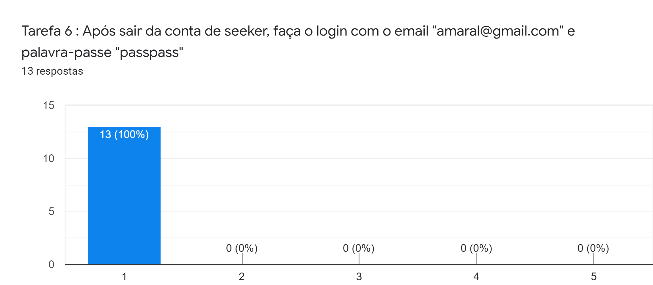
User Evaluation of the Functional Prototype - Results
Slinder
Overall, the difficulty on the tasks was low.
HCI 2019-2020
15

Slide 16
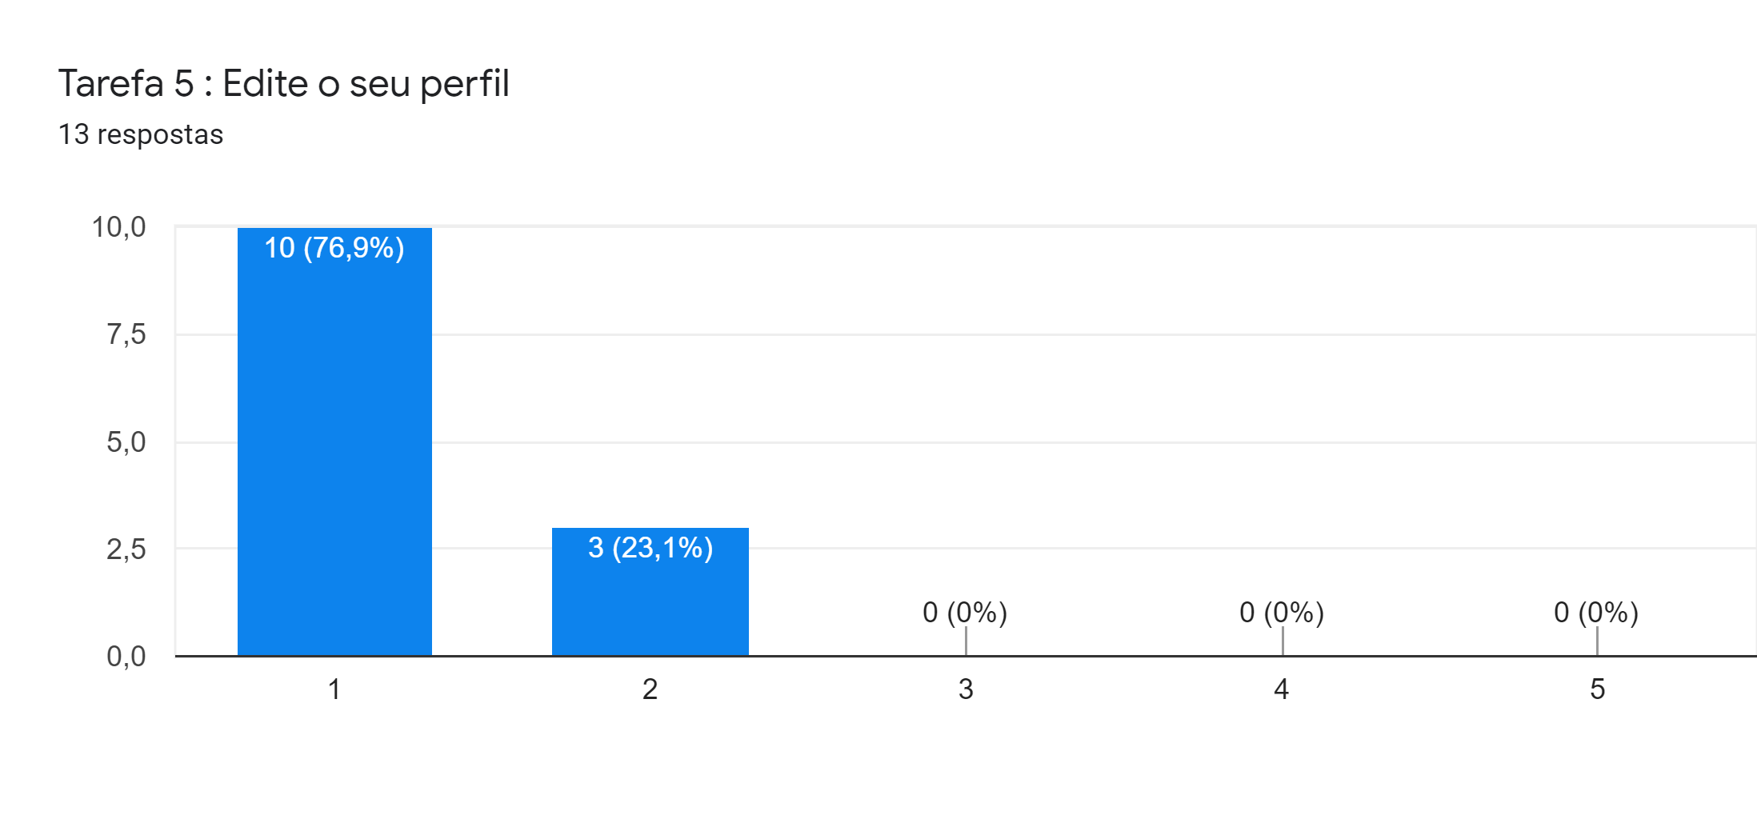
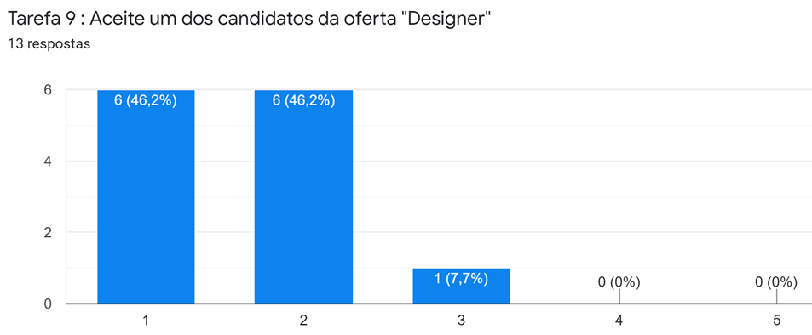
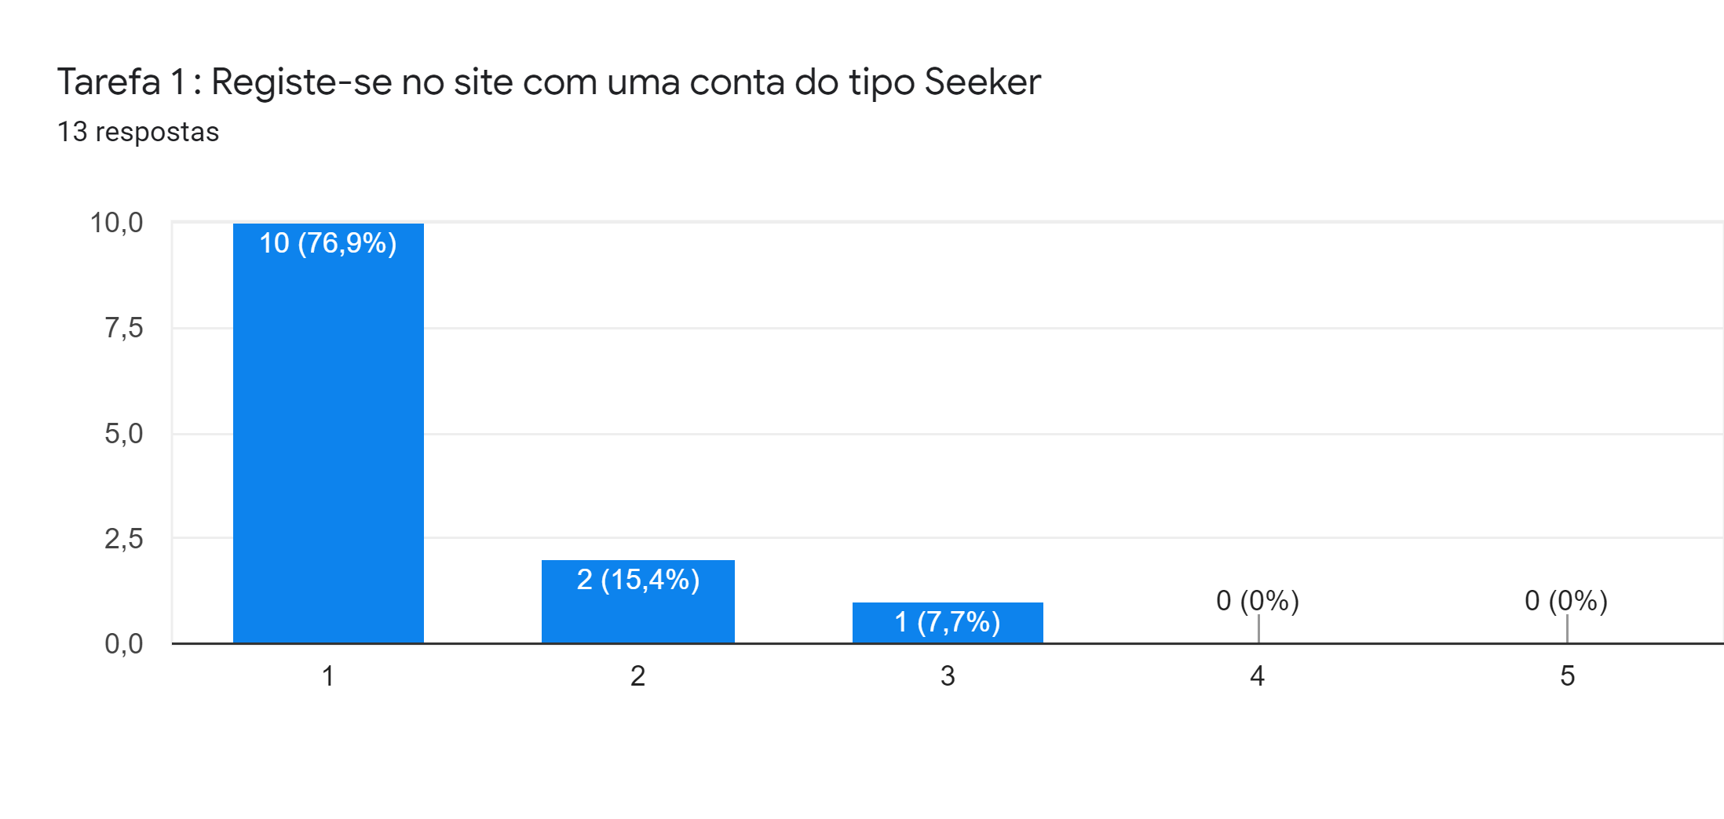
User Evaluation of the Functional Prototype - Results
Slinder
The edit profile task and the accept candidate task were the exceptions;
The register task has also shown some difficulties, but we think that is due to be the first task.
HCI 2019-2020
16

Slide 17
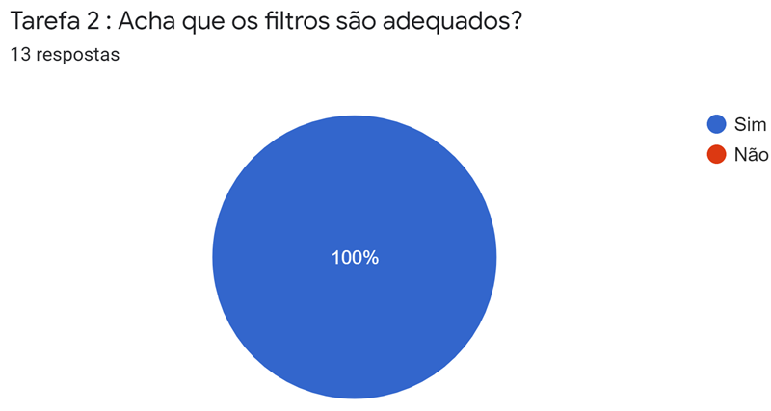
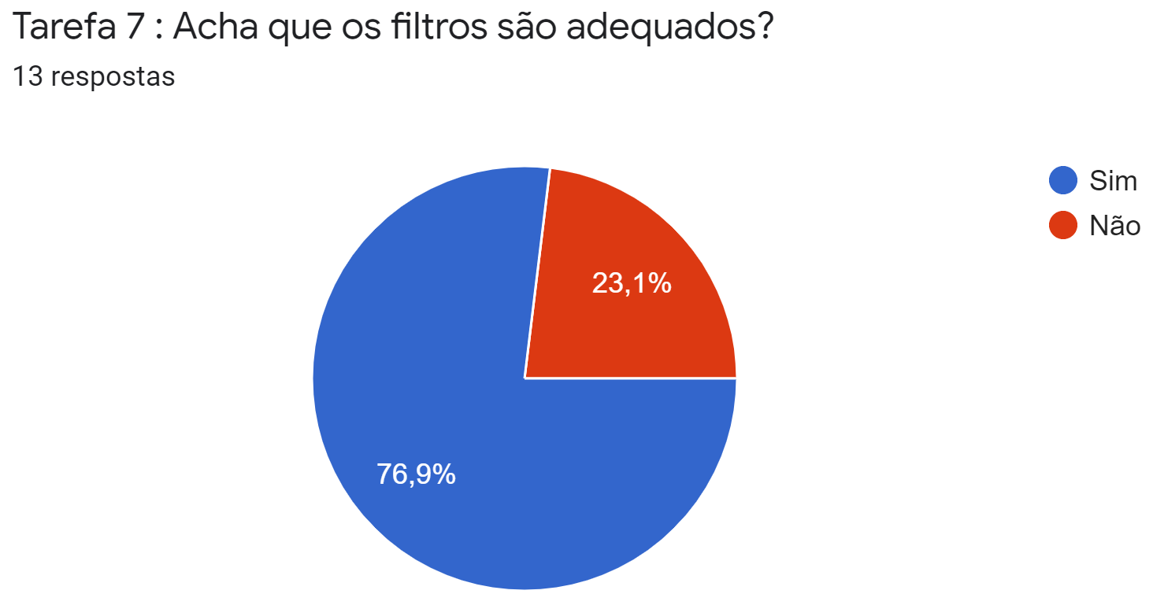
User Evaluation of the Functional Prototype - Results
Slinder
The users have shown some disagreement on the recruiter filters.
HCI 2019-2020
17

Slide 18
User Evaluation of the Functional Prototype - Results
Slinder
Made edit profile button more visible;
Added more filters to the job offers from the recruiters’ main page;
Added a confirm box when accepting/rejecting a candidate;
Added a cancel button to the add offer page;
Added a confirm password box;
Made the task “view candidate profile” more obvious to the user.
HCI 2019-2020
18

Slide 19
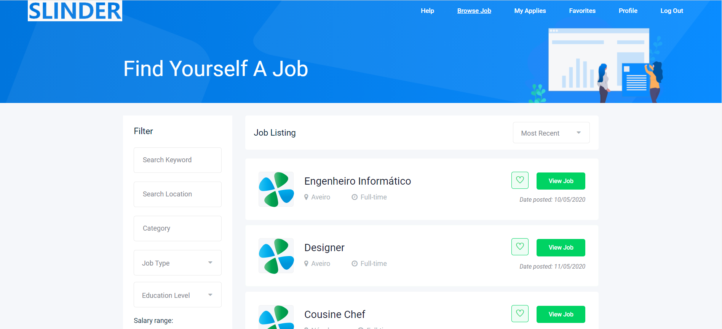
Demo
Slinder
HCI 2019-2020
19

Slide 20
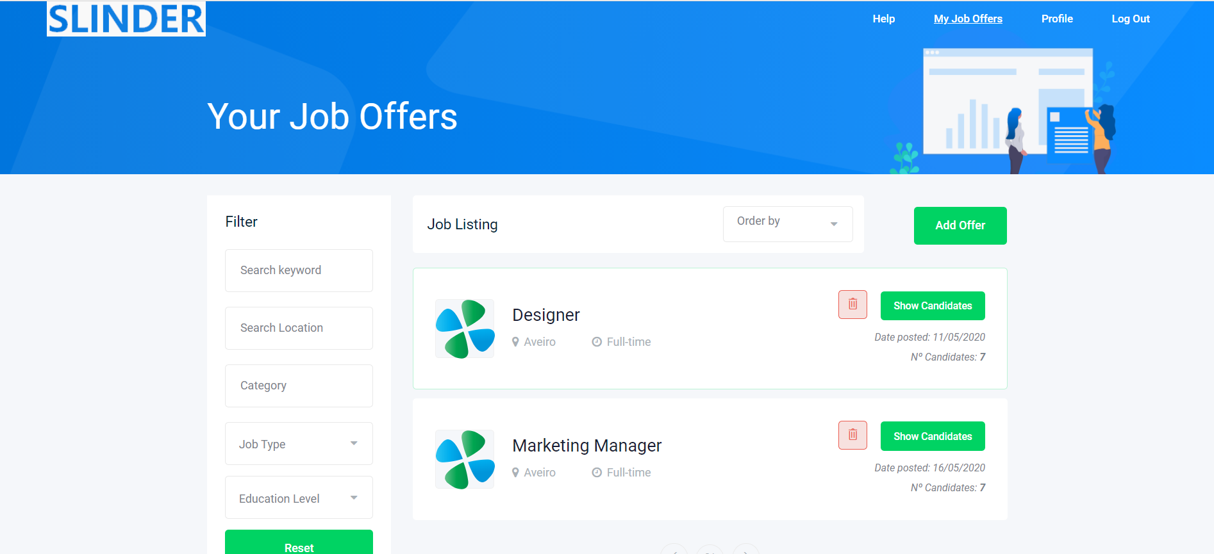
Demo
Slinder
HCI 2019-2020
20

Slide 21
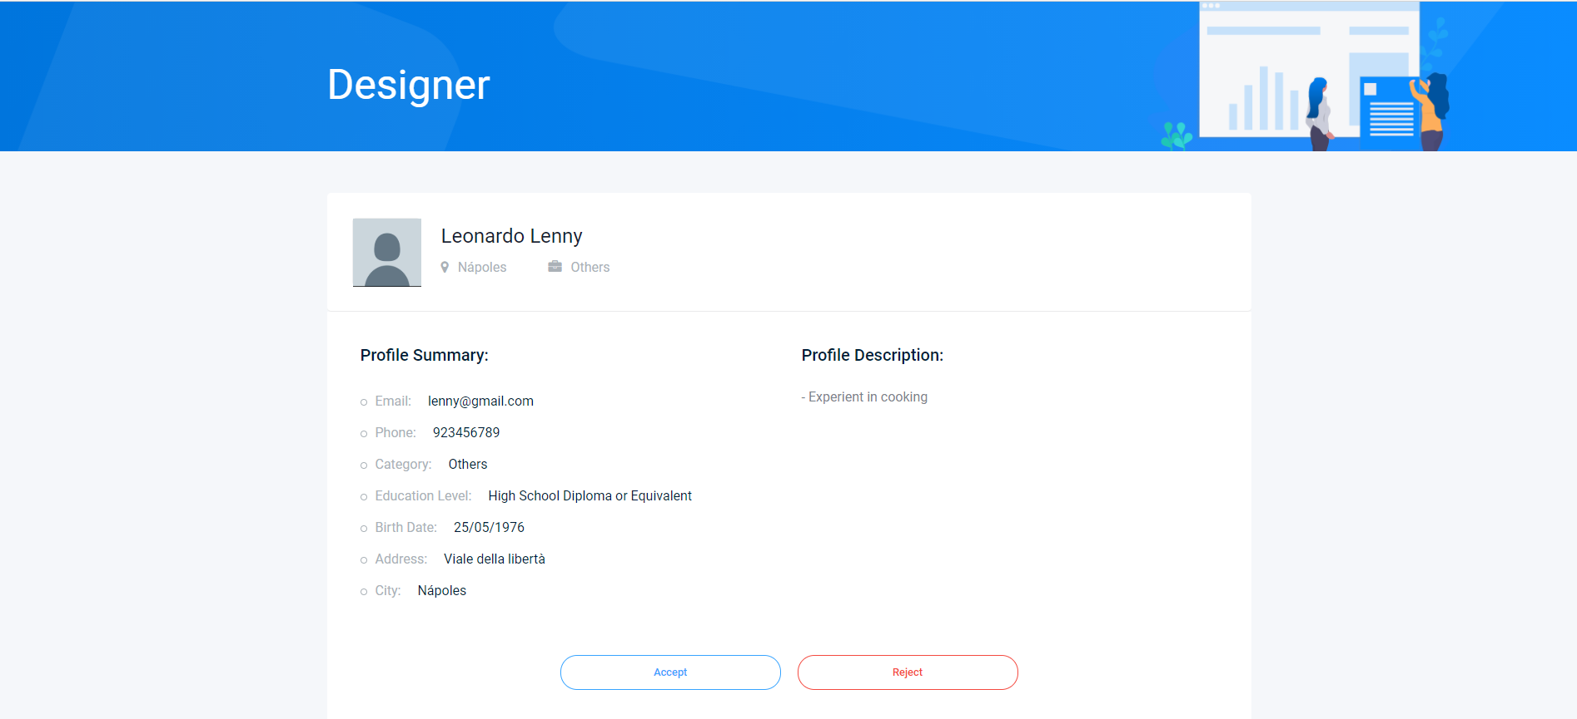
Demo
Slinder
HCI 2019-2020
21

Slide 22
Future Work
Slinder
Implement the filters, list of candidates, favourites, profile edition,…
Use a true database system.
HCI 2019-2020
22

Slide 23
Acknowledgments
Thanks to our friends and family for testing our project and giving good advices about it.
Effort of each group member
Same effort
HCI 2019-2020
23

